Slide 1
Eye In-Painting with Exemplar Generative Adversarial Networks Dolhansky, Brian, and Cristian Canton Ferrer, " Proceedings of the IEEE conference on computer vision and pattern recognition", 2018.
Adit Rastogi (2022A7PS1330H)
Srikanth Mujjiga (2024PHXP0507H)

Slide 2
Overview
Challenge:
Traditional in-painting lacks identity preservation
E.g: Generated eyes may not match the person’s true eye shape/color).
Humans are sensitive to facial inconsistencies ("uncanny valley").
One possible Solution: ExGANs use exemplar images/codes to guide in-painting.
Key Idea:
Conditional GAN variant leveraging exemplar data (reference images or perceptual codes).
Two Variants
Reference image based ExGANs: Use a second image of the same person as guidance.
Perceptual code based ExGANs: compressed perceptual code (vector) from a reference image to capture identity traits.

Slide 3
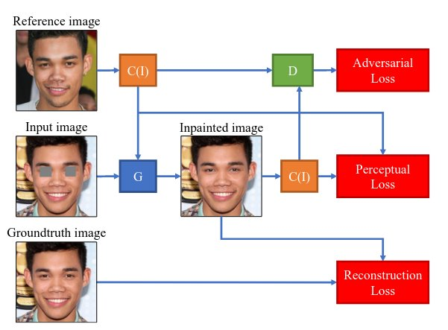
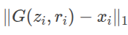
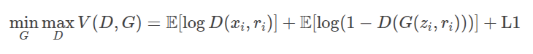
Architecture
Generator:
Exemplar Encoder: U-Net trained end to end as autoencoder
U-Net encoder layer later used for generating codes
Generated codes are concatenated with the convolved input inputs to generate the inpainted image
Discriminator: Dual-branch
Global: Evaluates full-face realism.
Local: Focuses on eye regions.
Loss Functions:
Adversarial Loss: Standard GAN min-max game.
Reconstruction Loss:
Perceptual Loss: Matches features in VGG space (optional).

Slide 4
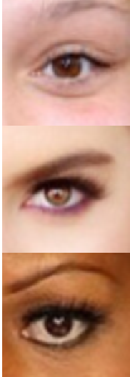
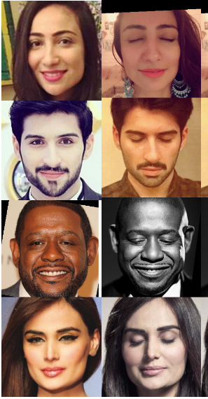
Dataset and Training
Dataset:
Pairs of images (original + reference eyes) from celebrity photos.
High resolution, varied lighting/poses.
2M image pairs
Training:
Subsampled to 50K pairs
Pretrained VGG for code generation
Adam optimizer with lr=0.0002 and beta1=0.5, beta2=0.999, weight_decay=1e-4
Scheduler: LR with step_size=30 and gamma=0.5
Trained for 100 epochs. Took 2 days on 1 NVIDIA RTX A6000 (48GB)

Slide 5
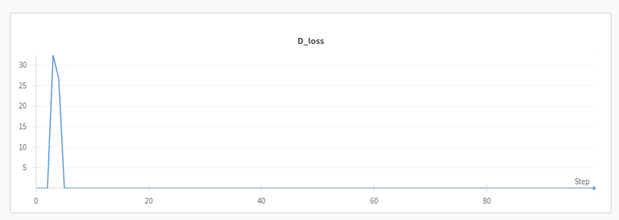
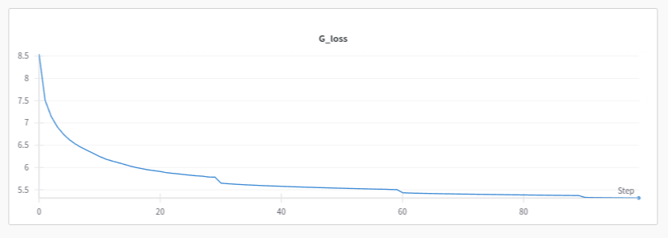
Loss
Discriminator Loss
Generator Loss

Slide 6
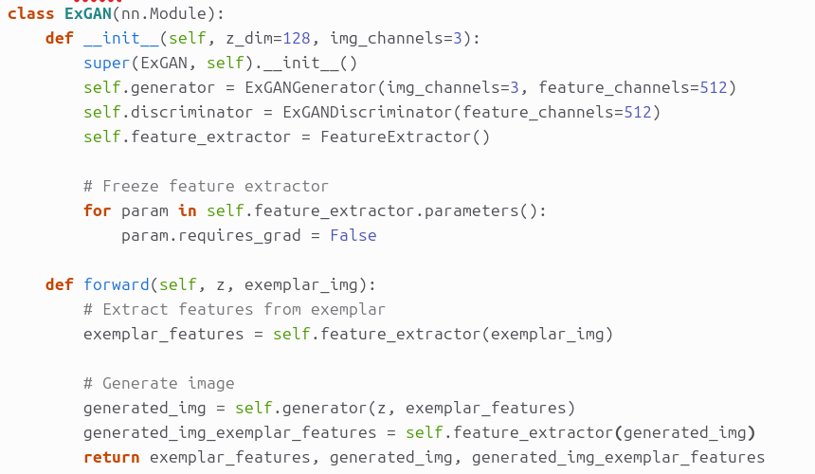
Generator

Slide 7
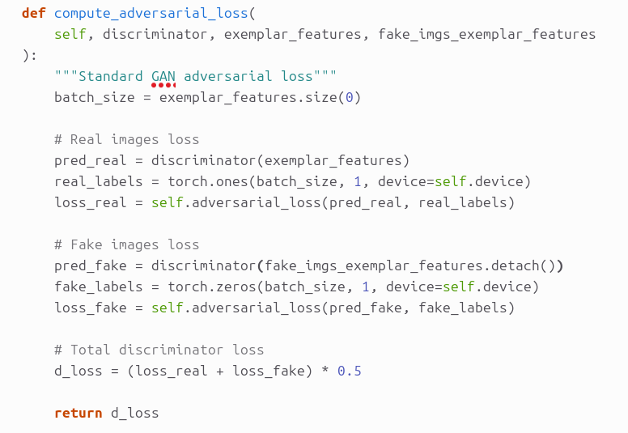

Discriminator

Slide 8
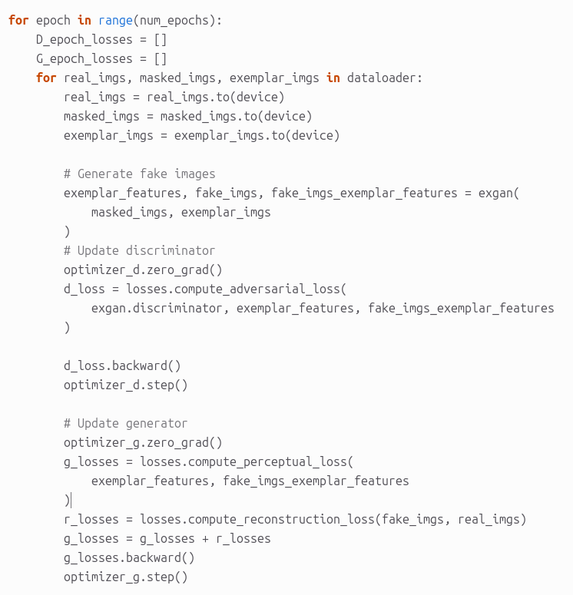
Training loop

Slide 9
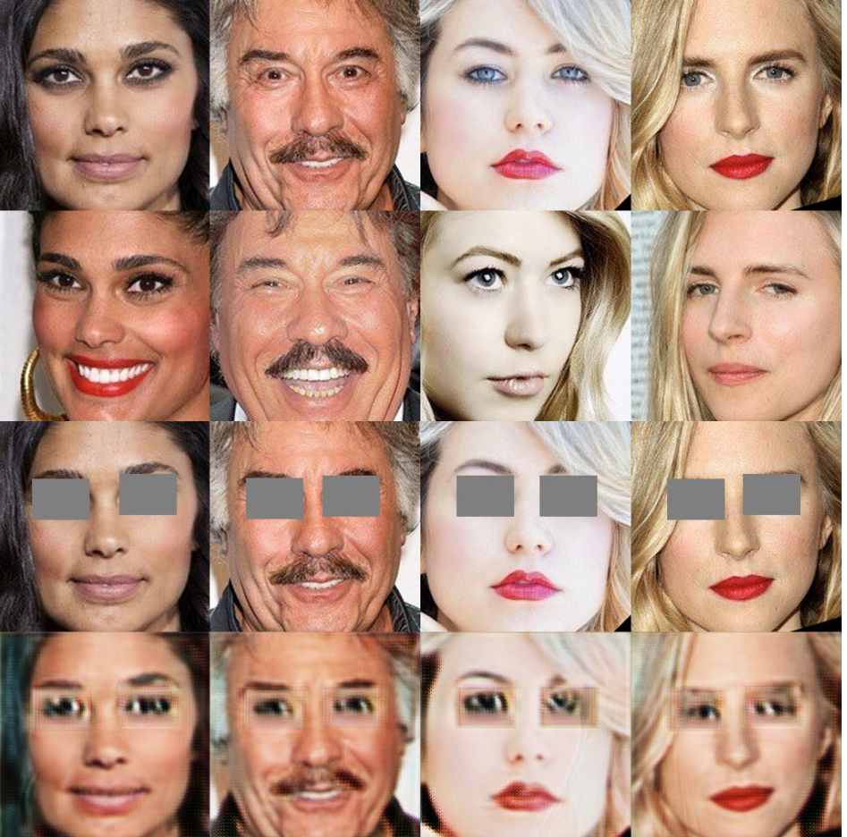
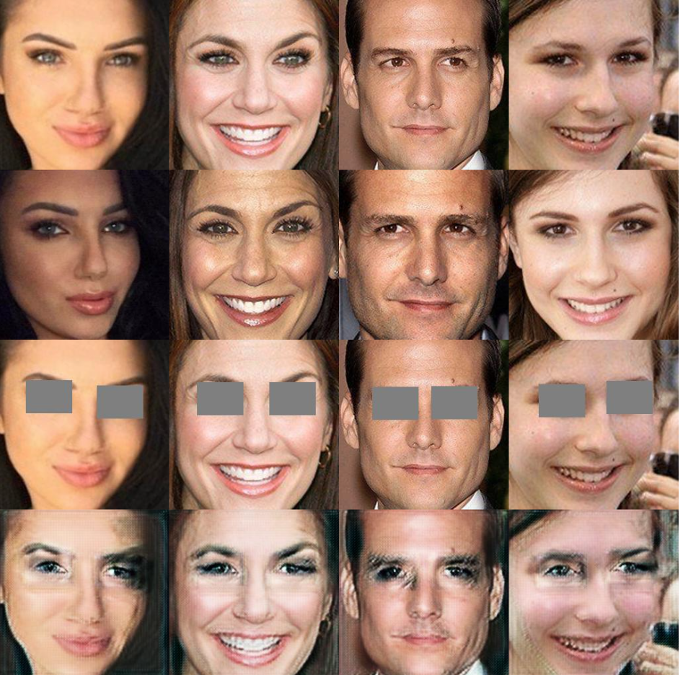
Results
Step: 400 Step: 2000

Slide 10
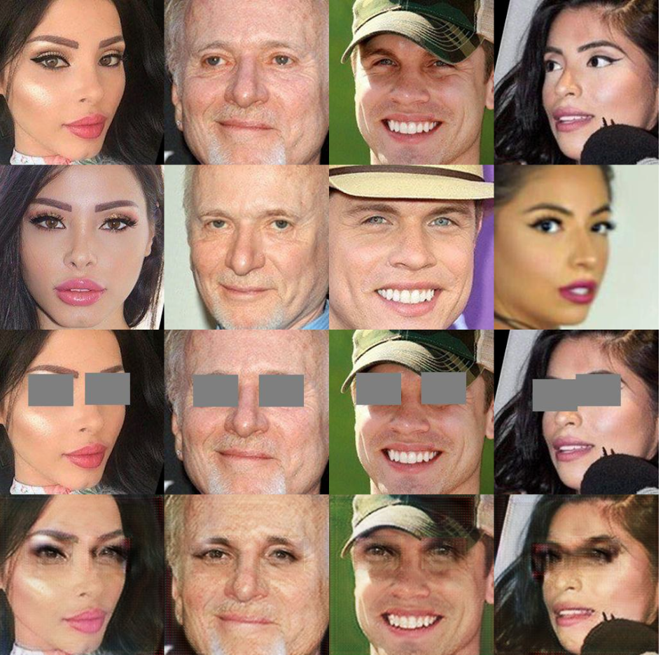
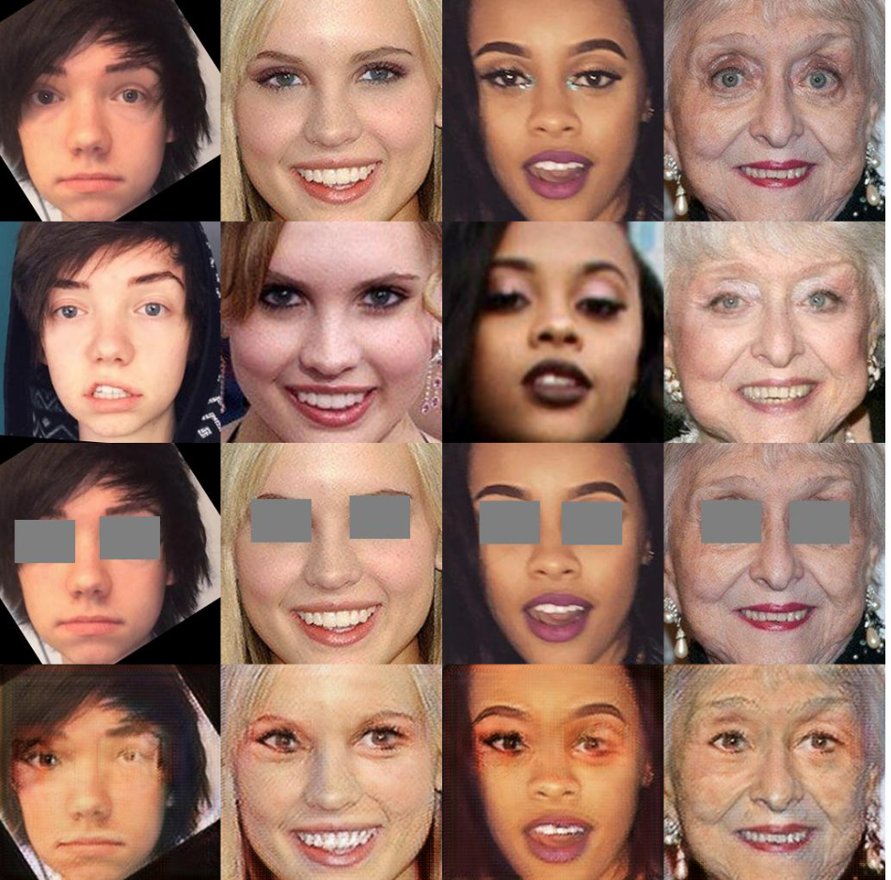
Results
Step: 4000 Step: 5600

Slide 11
Conclusion
Applications
Photo Editing: Fix closed/blurred eyes in portraits.
VR/AR: Generate realistic avatars from reference photos.
Medical Imaging: In-paint missing regions in scans while preserving patient-specific features.
Challenges:
Dataset: Square masks limit context
Training: iris color mismatches
Ethics: Potential misuse for deepfakes

